Slide 1
QUIZ!

Slide 2
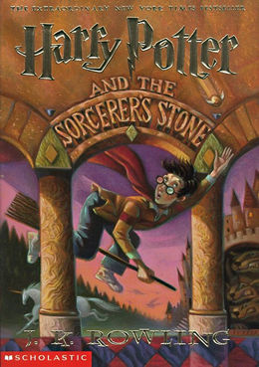
This hedge provides the street name for the Dursley family.
Privet

Slide 3
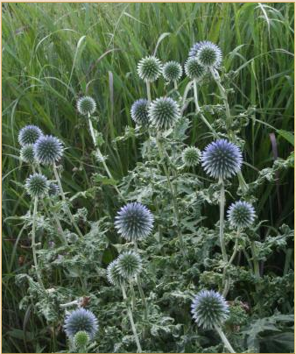
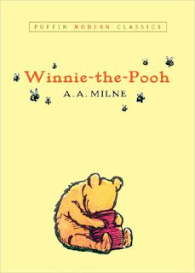
This is what Eeyore eats.
(Globe) Thistle

Slide 4
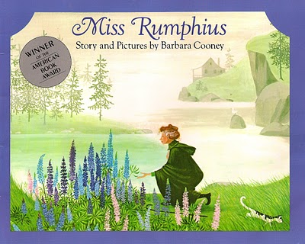
Miss Rumphius sows the seeds for this flower as her contribution to the world.
Lupine

Slide 5
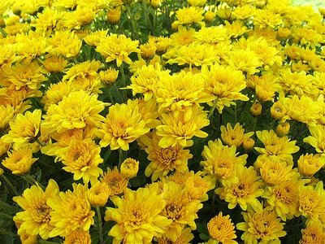
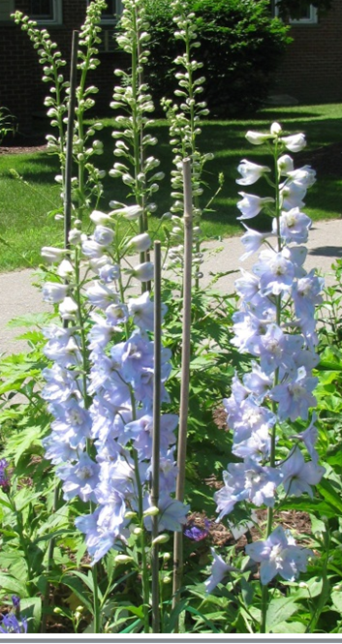
This flower is the name of a young mouse, teased during her first day of kindergarten. Bonus points for her Music teacher’s name.
Chrysanthemum
Delphinium

Slide 6
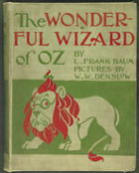
A wicked witch used this to put Dorothy and her friends to sleep.
Poppy

Slide 7
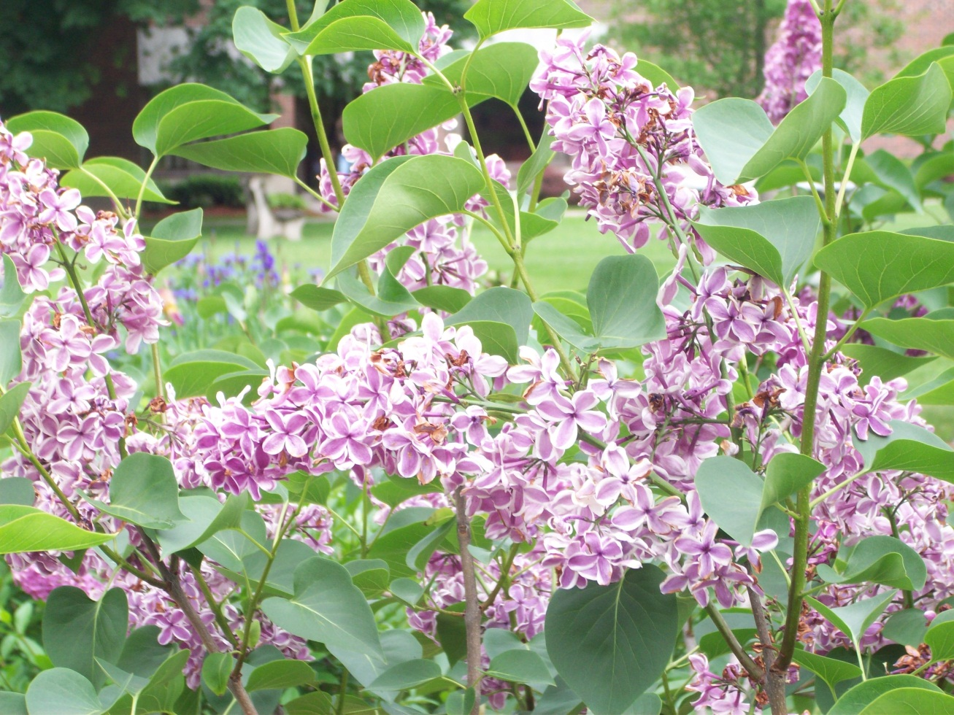
In The Secret Garden, Mary, Dickon, and Colin find these woody, flowering plants.
Lilac

Slide 8
Klara’s grandmother gives her seeds for this “beautiful blue flower” to take with her to America in Klara’s New World.
Gentian

Slide 9
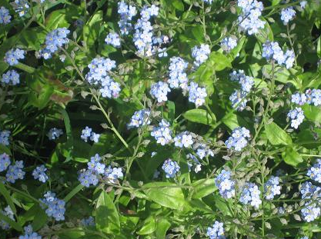
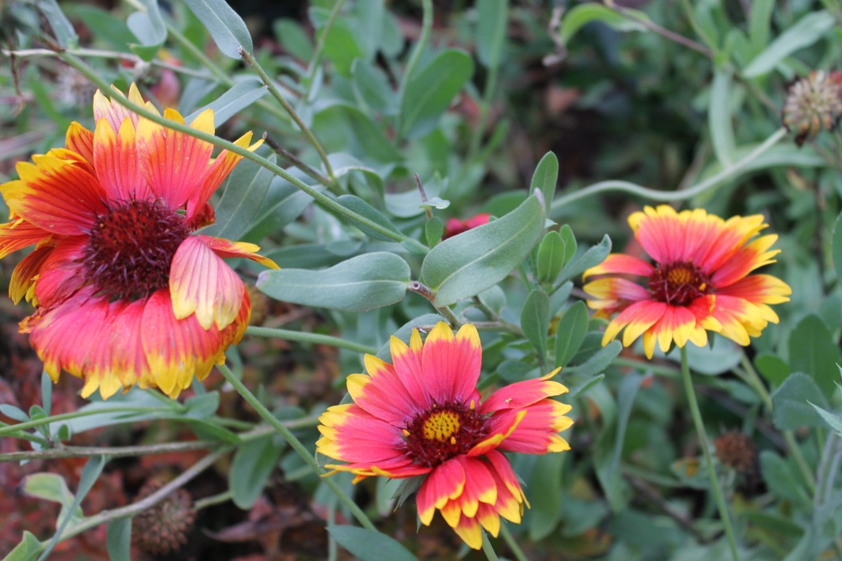
In the alliterative alphabet book by Anita Lobel, Alison’s Zinnia, Florence finds a flower beginning with “F” to give to Gloria. Bonus: What is Gloria’s flower?
Forget-Me-Not
Gaillardia

Slide 10
The main character in Natalie Kinsey-Warnock’s book, As Long As There Are Mountains is named after this flower.
Iris

Slide 11
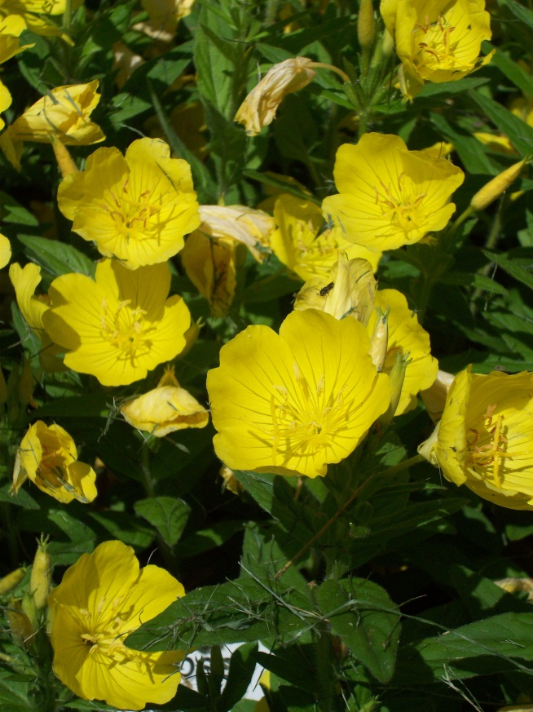
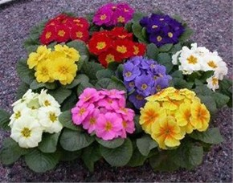
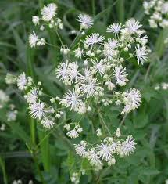
Grand finale: Name three books that have “primrose” as a character’s name:
Eggs, by Jerry Spinelli
Everything On A Waffle, by Peggy Horvath
The Hunger Games, by Suzanne Collins
(And yes, we plan to plant Meadow Rue)

